Slide 1
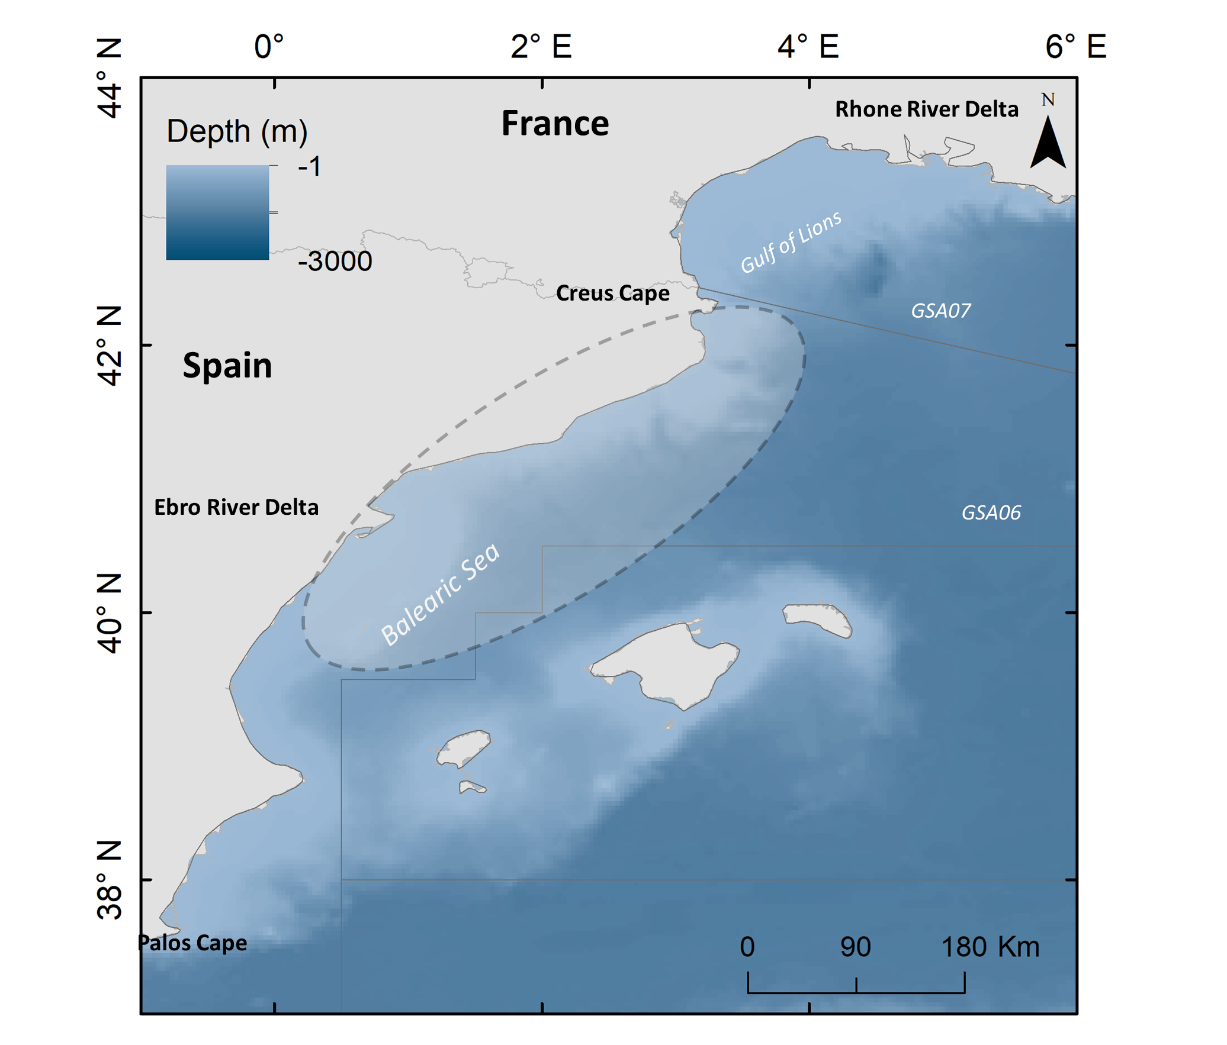

Slide 2
a) Fishing effort
b) Landings
c) Revenues
d) LPUE (landings productivity)
e) EPUE (economic productivity)

Slide 3
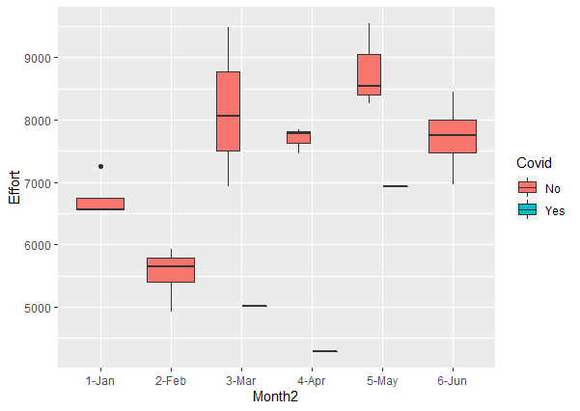
a) Fishing effort
Call:
glm(formula = Effort ~ Covid, family = gaussian, data = data)
Deviance Residuals:
Min 1Q Median 3Q Max
-2404.62 -774.62 28.88 784.38 2219.38
Coefficients:
Estimate Std. Error t value Pr(>|t|)
(Intercept) 7330.6 270.3 27.120 <2e-16 ***
CovidYes -1920.3 764.5 -2.512 0.0199 *
---
Signif. codes: 0 ‘***’ 0.001 ‘**’ 0.01 ‘*’ 0.05 ‘.’ 0.1 ‘ ’ 1
(Dispersion parameter for gaussian family taken to be 1534370)
Null deviance: 43435820 on 23 degrees of freedom
Residual deviance: 33756140 on 22 degrees of freedom
AIC: 413.87
Number of Fisher Scoring iterations: 2

Slide 4
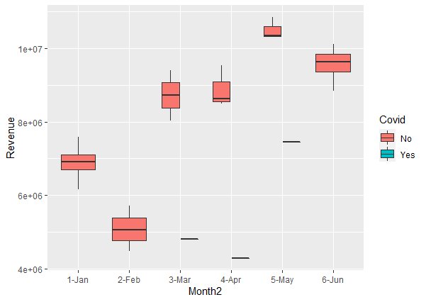
b) Landings
Call:
glm(formula = Revenue ~ Covid, family = gaussian, data = data2)
Deviance Residuals:
Min 1Q Median 3Q Max
-3632559 -1231624 443604 1472000 2736127
Coefficients:
Estimate Std. Error t value Pr(>|t|)
(Intercept) 8118662 420089 19.326 2.72e-15 ***
CovidYes -2604067 1188190 -2.192 0.0393 *
---
Signif. codes: 0 ‘***’ 0.001 ‘**’ 0.01 ‘*’ 0.05 ‘.’ 0.1 ‘ ’ 1
(Dispersion parameter for gaussian family taken to be 3.705965e+12)
Null deviance: 9.9332e+13 on 23 degrees of freedom
Residual deviance: 8.1531e+13 on 22 degrees of freedom
AIC: 766.6
Number of Fisher Scoring iterations: 2

Slide 5
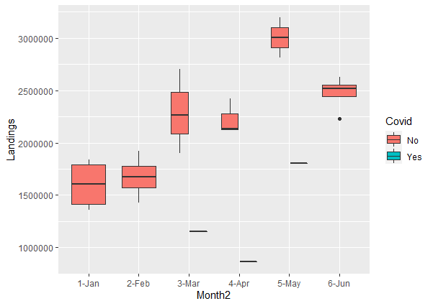
c) Revenues
Call:
glm(formula = Landings ~ Covid, family = gaussian, data = data3)
Deviance Residuals:
Min 1Q Median 3Q Max
-809379 -397066 -42350 379344 1028343
Coefficients:
Estimate Std. Error t value Pr(>|t|)
(Intercept) 2169550 114861 18.888 4.39e-15 ***
CovidYes -893704 324877 -2.751 0.0117 *
---
Signif. codes: 0 ‘***’ 0.001 ‘**’ 0.01 ‘*’ 0.05 ‘.’ 0.1 ‘ ’ 1
(Dispersion parameter for gaussian family taken to be 277055360198)
Null deviance: 8.1918e+12 on 23 degrees of freedom
Residual deviance: 6.0952e+12 on 22 degrees of freedom
AIC: 704.36
Number of Fisher Scoring iterations: 2

Slide 6
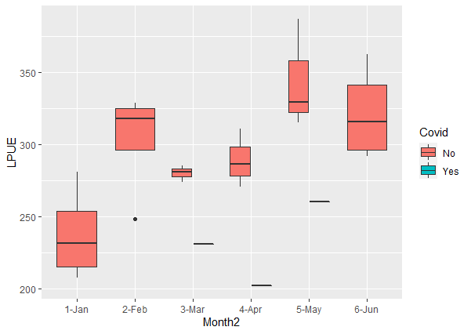
d) LPUE (landings productivity)
Call:
glm(formula = LPUE ~ Covid, family = gaussian, data = data4)
Deviance Residuals:
Min 1Q Median 3Q Max
-87.266 -21.631 -1.544 28.877 92.420
Coefficients:
Estimate Std. Error t value Pr(>|t|)
(Intercept) 294.641 9.345 31.530 <2e-16 ***
CovidYes -63.581 26.431 -2.406 0.025 *
---
Signif. codes: 0 ‘***’ 0.001 ‘**’ 0.01 ‘*’ 0.05 ‘.’ 0.1 ‘ ’ 1
(Dispersion parameter for gaussian family taken to be 1833.857)
Null deviance: 50957 on 23 degrees of freedom
Residual deviance: 40345 on 22 degrees of freedom
AIC: 252.36
Number of Fisher Scoring iterations: 2

Slide 7
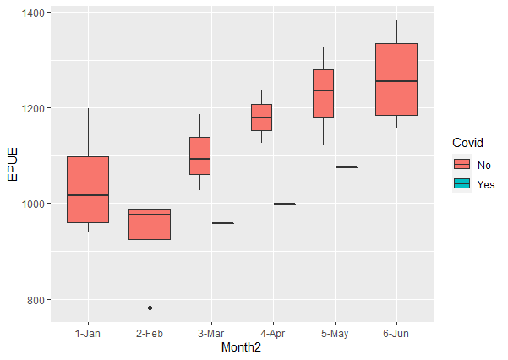
e) EPUE (economic productivity)
Call:
glm(formula = EPUE ~ Covid, family = gaussian, data = data5)
Deviance Residuals:
Min 1Q Median 3Q Max
-337.02 -95.80 5.61 75.66 263.82
Coefficients:
Estimate Std. Error t value Pr(>|t|)
(Intercept) 1118.85 30.91 36.200 <2e-16 ***
CovidYes -107.67 87.42 -1.232 0.231
---
Signif. codes: 0 ‘***’ 0.001 ‘**’ 0.01 ‘*’ 0.05 ‘.’ 0.1 ‘ ’ 1
(Dispersion parameter for gaussian family taken to be 20060.17)
Null deviance: 471757 on 23 degrees of freedom
Residual deviance: 441324 on 22 degrees of freedom
AIC: 309.78
Number of Fisher Scoring iterations: 2

